Slide 1
New York City Parking Tickets

Slide 2
Data Source
From NYC OpenData
Fiscal Year 2014 : https://data.cityofnewyork.us/City-Government/Parking-Violations-Issued-Fiscal-Year-2014/jt7v-77mi
Fiscal Year 2015: https://data.cityofnewyork.us/City-Government/Parking-Violations-Issued-Fiscal-Year-2015/c284-tqph
Fiscal Year 2016: https://data.cityofnewyork.us/City-Government/Parking-Violations-Issued-Fiscal-Year-2016/kiv2-tbus
Fiscal Year 2017: https://data.cityofnewyork.us/City-Government/Parking-Violations-Issued-Fiscal-Year-2017/2bnn-yakx

Slide 3
Hardware Specifications - Google Dataproc
-Master node
Standard (1 master, N workers)
-Machine type
n1-standard-4 (4 vCPU, 15.0 GB memory)
-Primary disk type
pd-standard
-Primary disk size
500 GB
-Worker nodes
2
-Machine type
n1-standard-4 (4 vCPU, 15.0 GB memory)
-Primary disk type
pd-standard
-Primary disk size
500 GB

Slide 4
Hardware Specifications cont.
Image Version:1.3.45-debian9
Applications: Hadoop 2.9.2, Spark 2.3.4, Hive 2.3.5, Pig 0.17.0, Tez 0.9.2

Slide 5
Ticket Summary
CREATE EXTERNAL TABLE IF NOT EXISTS tickets_summary
(summons_number INT, plate_id STRING, vehicle_make STRING, vehicle_body_type STRING, vehicle_color STRING, violation_code STRING, violation_location STRING)
ROW FORMAT DELIMITED FIELDS TERMINATED BY ','
STORED AS TEXTFILE LOCATION '/output/tickets_summary'
TBLPROPERTIES ('skip.header.line.count'='1');
INSERT OVERWRITE TABLE tickets_summary SELECT summons_number, plate_id, vehicle_make, vehicle_body_type, vehicle_color, violation_code, violation_location FROM tickets;
select * from tickets_summary LIMIT 10;

Slide 6
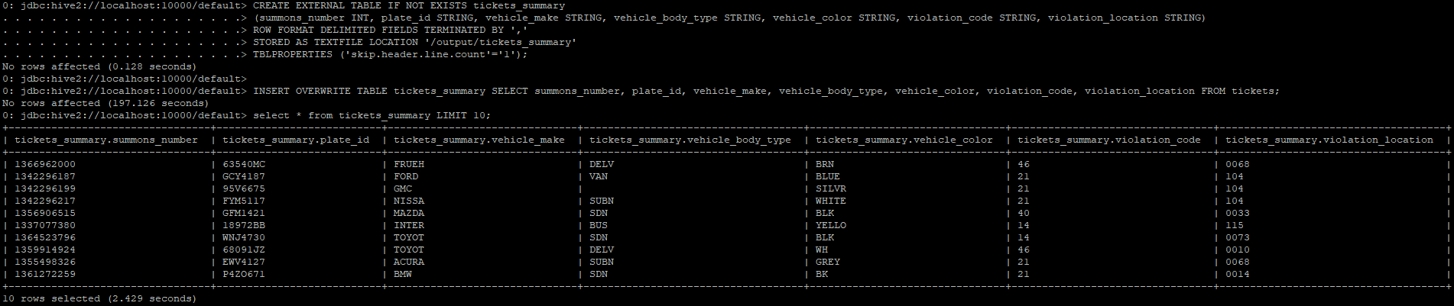
Results

Slide 7
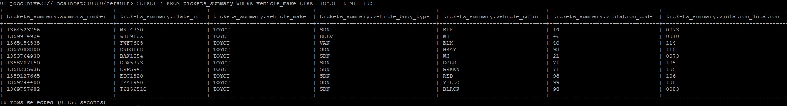
How many tickets were given to Toyotas
SELECT * FROM tickets_summary WHERE vehicle_make LIKE 'TOYOT' LIMIT 10;

Slide 8
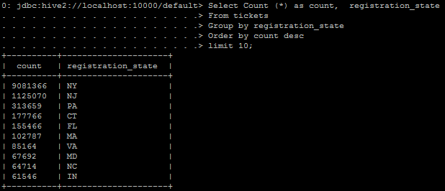
Top 10 Registration State by number

Slide 9
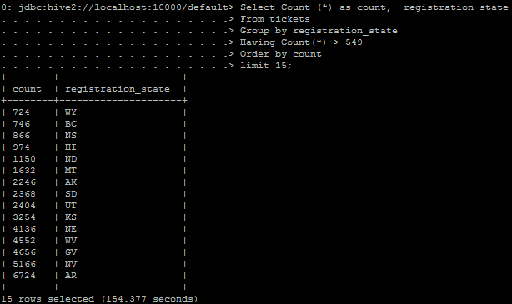
Bottom 15 Registration State by number

Slide 10
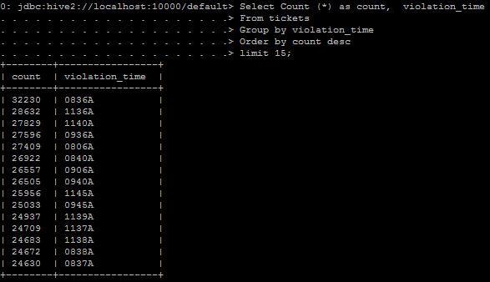
Top 15 Violation times

Slide 11
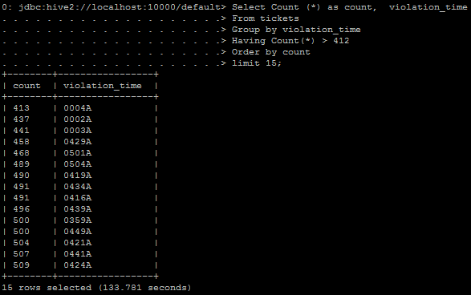
Bottom 15 Violation time

Slide 12
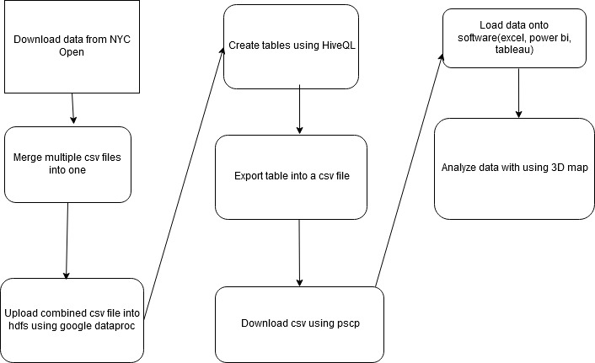

Slide 13
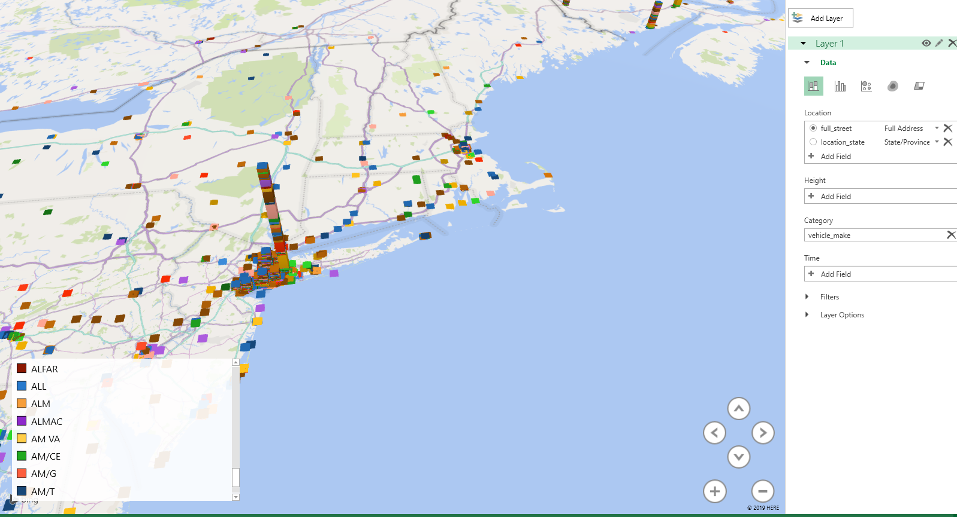
Visualization

